Slide 1



#BuyDonegal
Nov 20th – Dec 22nd 2023
Visit BuyDonegal.com

Slide 2
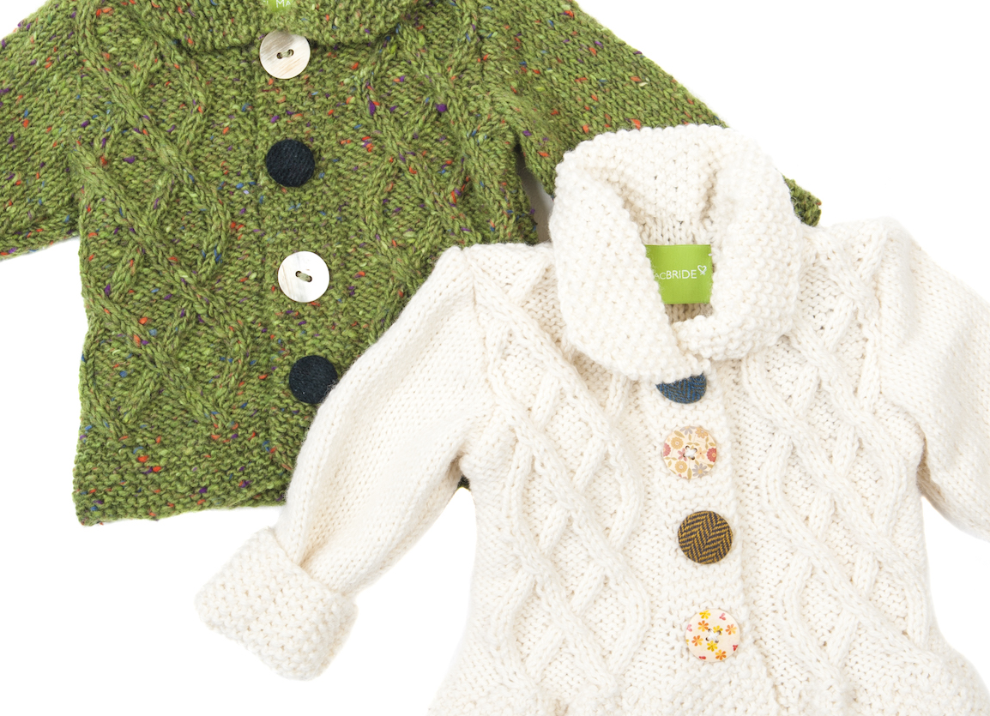

#BuyDonegal
Nov 20th – Dec 22nd 2023
Visit BuyDonegal.com

Slide 3
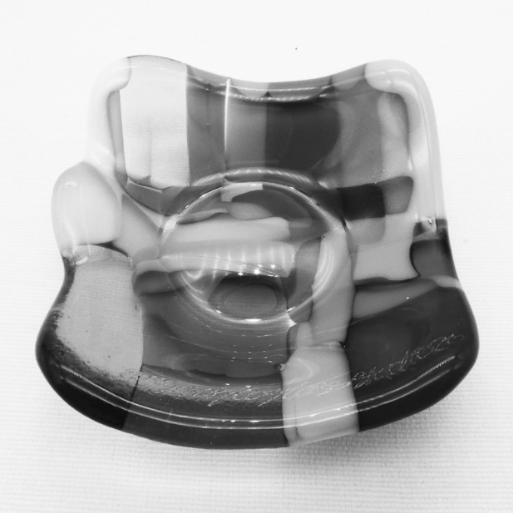


#Buy
Donegal
Nov 20th – Dec 22nd 2023
Visit BuyDonegal.com

Slide 4

#Buy
Donegal
Nov 20th – Dec 22nd 2023
Visit BuyDonegal.com

Slide 5



#Buy
Donegal
Nov 20th – Dec 22nd 2023
Visit BuyDonegal.com

Slide 6



#BuyDonegal
Nov 20th – Dec 22nd 2023
Visit BuyDonegal.com

Slide 7

#BuyDonegal
Nov 20th – Dec 22nd 2023
Visit BuyDonegal.com

